Slide 1


Does God Engage in Destructive Behavior?
Lesson Six
Satan is the Destroyer (Part 2)

Slide 2
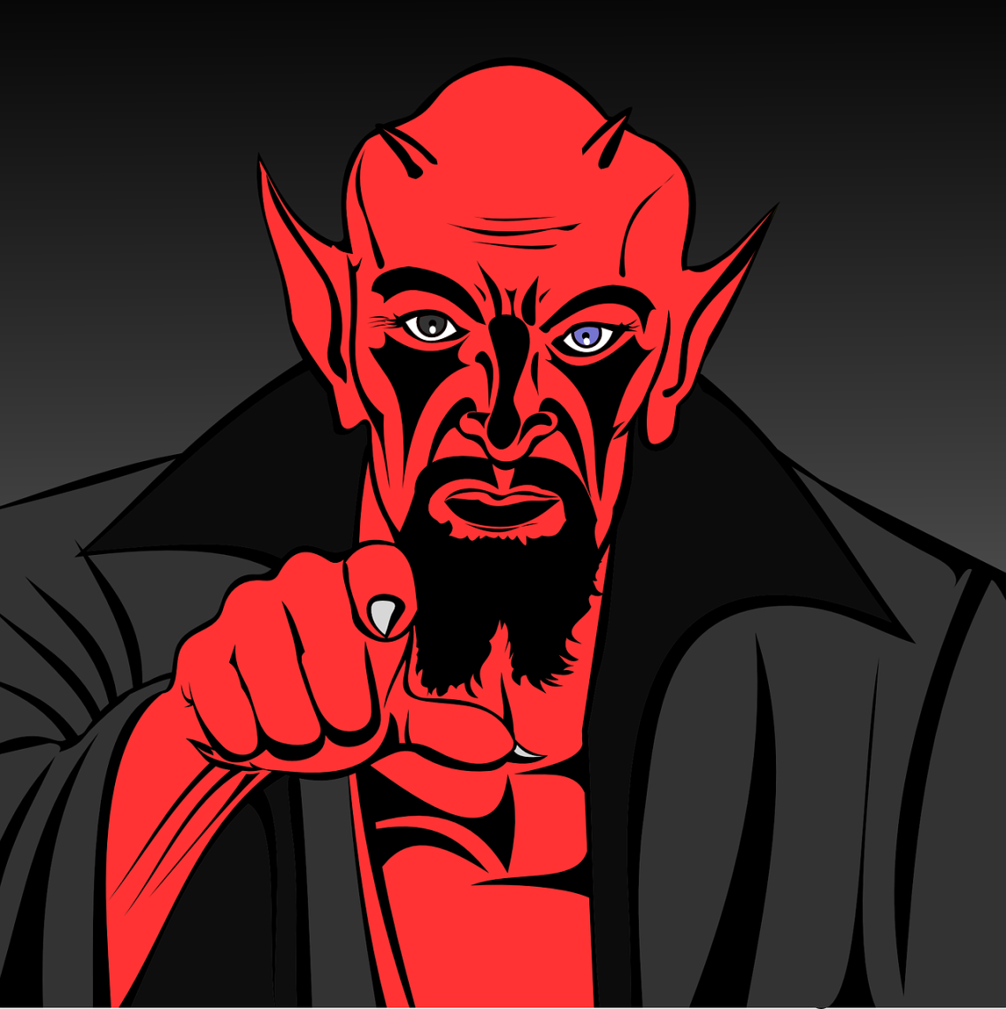

You Foolish Christians
I have deceived you into blaming everything I do on God’s
sovereignty. Now you just submit to all my evil deeds
instead of standing against me. I like that!
“Put on the whole armour of God, that ye may be able to
stand against the wiles of the devil.” (Eph. 6:11)

Slide 3


1. God takes responsibility for creating the destroyer
Behold, I have created the smith that bloweth the coals in the fire, and him that bringeth forth an instrument for his work, and I have created the destroyer to destroy (Isa. 54:16; 1599 Geneva Bible)

Slide 4
1. God takes responsibility for creating the destroyer
“Thou wast perfect in thy ways from the day that thou wast created, till iniquity was found in thee” (Eze. 28:16).

Slide 5
1. God takes responsibility for creating the destroyer
Iniquity was found in Satan so God did not put it there. Everything that Satan does is of his own initiative (John 8:44). Satan’s desire to destroy is opposed to God’s desire to protect and give life (John 10:10).

Slide 6
2. God Takes Responsibility for what Satan Does
But put forth thine hand now, and touch all that he hath, and he will curse thee to thy face. And the Lord said unto Satan, Behold, all that he hath is in thy power; only upon himself put not forth thine hand. So Satan went forth from the presence of the Lord (Job 1:11-12)

Slide 7
2. God Takes Responsibility for what Satan Does
Satan then uses natural disasters and evil men to destroy Job’s family, servants, and livestock. God did none of it. He did not even suggest or remotely hint to Satan to do any of this. Yet, in the very next chapter of Job we find God taking responsibility for Job’s destruction

Slide 8
2. God Takes Responsibility for what Satan Does
And the Lord said unto Satan, Hast thou considered my servant Job, that there is none like him in the earth, a perfect and an upright man, one that feareth God, and escheweth evil? and still he holdeth fast his integrity, although thou movedst me against him, to destroy him without cause. (Job 2:3)

Slide 9
3. Satan is the Destroyer of Egypt’s Firstborn
Exodus 12:12a: “For I will pass through the land of Egypt this night, and will smite all the firstborn in the land of Egypt, both man and beast.”

Slide 10
3. Satan is the Destroyer of Egypt’s Firstborn
God is said to be the One doing the smiting (bringing death and sickness upon man and beast). Now let us skip down to verse 23:

Slide 11
3. Satan is the Destroyer of Egypt’s Firstborn
“For the LORD will pass through to smite the Egyptians; and when he seeth the blood upon the lintel, and on the two side posts, the LORD will pass over the door, and will not suffer the destroyer to come in unto your houses to smite you.” (Ex. 12:23)

Slide 12
3. Satan is the Destroyer of Egypt’s Firstborn
The Hebrew word for “passover” in Ex. 12:23 is the same word used in Isaiah 31:5: “As birds flying, so will the LORD of hosts defend Jerusalem; defending also he will deliver it; and passing over he will preserve it.”
Therefore “Passover” is not God skipping the house that had blood but rather God guarding, preserving and protecting that house from the destroyer.

Slide 13
3. Satan is the Destroyer of Egypt’s Firstborn
“Through faith he kept the passover, and the sprinkling of blood, lest he that destroyed the firstborn should touch them” (Heb. 11:28).
In 1 John 5:18 we read, “....but he who has been born of God keeps himself, and the wicked one does not touch him” (NKJV).

Slide 14
3. Satan is the Destroyer of Egypt’s Firstborn
He let loose on them his fierce anger, wrath, indignation, and distress, a company of destroying angels. He made a path for his anger; he did not spare them from death, but gave their lives over to the plague. He smote all the first-born in Egypt, the first issue of their strength in the tents of Ham (Psalm 78:49-51; Revised Standard Version)

Slide 15
4. Satan is the Destroyer in the Wilderness
And the people spake against God, and against Moses, Wherefore have ye brought us up out of Egypt to die in the wilderness? for there is no bread, neither is there any water; and our soul loatheth this light bread. And the Lord sent fiery serpents among the people, and they bit the people; and much people of Israel died (Num. 21:5-6)

Slide 16
4. Satan is the Destroyer in the Wilderness
The Hebrew word for sent is shalach, which again means allow or permit.

Slide 17
4. Satan is the Destroyer in the Wilderness
The Leeser Old Testament renders verse 6, “And the Lord let loose against the people poisonous serpents, and they bit the people; and there died much people of Israel.”

Slide 18
4. Satan is the Destroyer in the Wilderness
Neither let us commit fornication, as some of them committed, and fell in one day three and twenty thousand. Neither let us tempt Christ, as some of them also tempted, and were destroyed of serpents. Neither murmur ye, as some of them also murmured, and were destroyed of the destroyer (1 Cor. 10:8-10)

Slide 19
4. Satan is the Destroyer in the Wilderness
Concerning this passage Albert Barnes writes, “….to presume on the grace of Christ to keep them in all circumstances, would be to tempt him, and provoke him to leave them.”

Slide 20
4. Satan is the Destroyer in the Wilderness
The Good News Translation of verse 10 says, “We must not complain, as some of them did—and they were destroyed by the Angel of Death.”

Slide 21
4. Satan is the Destroyer in the Wilderness
Satan held the power of death (Heb. 2:14) so we have no doubt that he is the destroyer in the wilderness.

Slide 22
5. Satan is the Destroyer in the End Times
Rev 9:2 And he opened the bottomless pit; and there arose a smoke out of the pit, as the smoke of a great furnace; and the sun and the air were darkened by reason of the smoke of the pit.
Rev 9:3 And there came out of the smoke locusts upon the earth: and unto them was given power, as the scorpions of the earth have power.
Rev 9:4 And it was commanded them that they should not hurt the grass of the earth, neither any green thing, neither any tree; but only those men which have not the seal of God in their foreheads.

Slide 23
5. Satan is the Destroyer in the End Times
Rev 9:5 And to them it was given that they should not kill them, but that they should be tormented five months: and their torment was as the torment of a scorpion, when he striketh a man.
Rev 9:6 And in those days shall men seek death, and shall not find it; and shall desire to die, and death shall flee from them.

Slide 24
5. Satan is the Destroyer in the End Times
The Bible goes on to tell us that these are being reigned over, not by God, but by the one known as “the Destroyer:”

Slide 25
5. Satan is the Destroyer in the End Times
And they had tails like unto scorpions, and there were stings in their tails: and their power was to hurt men five months. And they had a king over them, which is the angel of the bottomless pit, whose name in the Hebrew tongue is Abaddon, but in the Greek tongue hath his name Apollyon (Rev. 9:10-11)

Slide 26
5. Satan is the Destroyer in the End Times
They have as king over them, the angel of the abyss (the bottomless pit); in Hebrew his name is Abaddon (destruction), and in Greek he is called Apollyon (destroyer-king). (The Amplified Bible)
The king of the locusts is the angel of the big hole that has no bottom. His name is Abaddon in the Jew's language and Apollyon in the Greek language. (This means, the one who destroys.) (Worldwide English New Testament)

Slide 27
5. Satan is the Destroyer in the End Times
“The secret power of evil is already working in the world now. But there is one who is stopping that secret power of evil. And he will continue to stop it until he is taken out of the way” (2 Thess. 2:7; Easy to Read Version).

